Slide 1

Module:5 Superconductivity
Basic Science (Physics) (BSP)
GTU # 3110018
Prof. Vishal S. Vadgama
Humanities and Science Department
vishal.vadgama@darshan.ac.in
+91 8866118980

Slide 2
Topic
Introduction of Superconductivity
Properties of superconductors:
➥ Electrical resistance/resistivity
➥ Effect of impurities
➥ Effect of Pressure and Stress
➥ Isotopic effect
➥ Effect of magnetic field
➥ Critical current density
➥ Persistent Current
➥ Meissner effect

Slide 3
Topic
Important factor that defines superconducting state
Types of superconductors
Mechanism of superconductivity: BCS theory
➥ Cooper pairs
➥ Energy gaps
➥ Coherence length
Penetration depth: London equation
Application of superconductors

Slide 4

Introduction of Superconductivity

Slide 5
Electricity
These outer-most orbit electrons are known by various names valence electrons, free
electrons, electric charge (Q), charge carriers, etc…
e⁻
L = 1 m
20
10
30
e⁻
e⁻
e⁻
e⁻
0
40
A
e⁻
e⁻
e⁻
e⁻
e⁻
e⁻
e⁻
e⁻
A
Cu (Wire)
The rate of flow of electric charge (e⁻) is known as current (I).

Slide 6

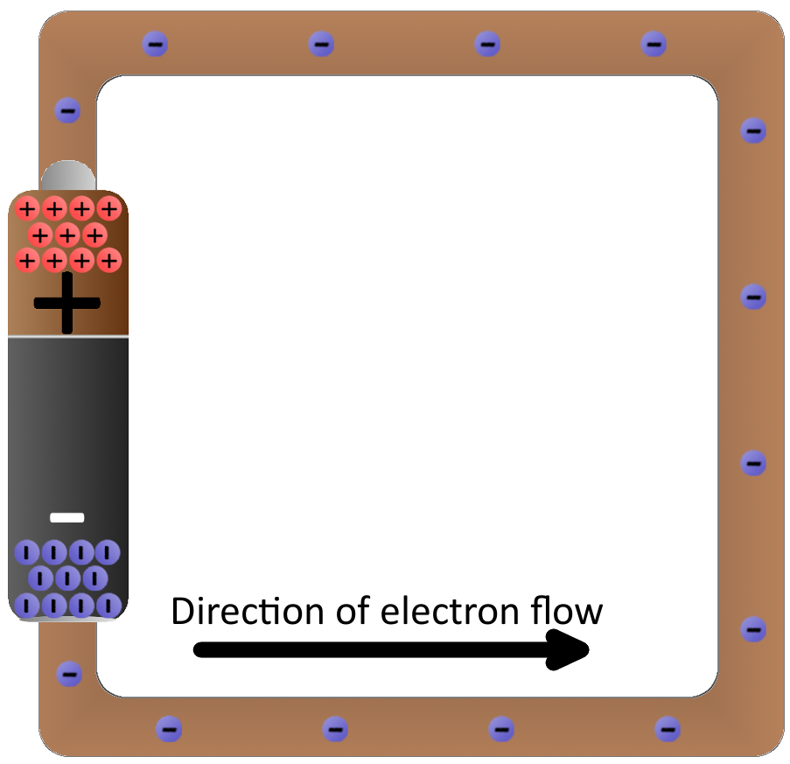
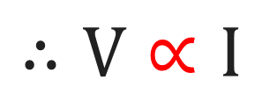
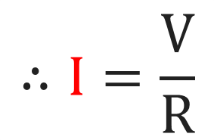

Resistance
Ohm’s law
$$∴V∝I$$
$$∴V=R I$$
$$∴I=\frac{V}{R}$$

Slide 7


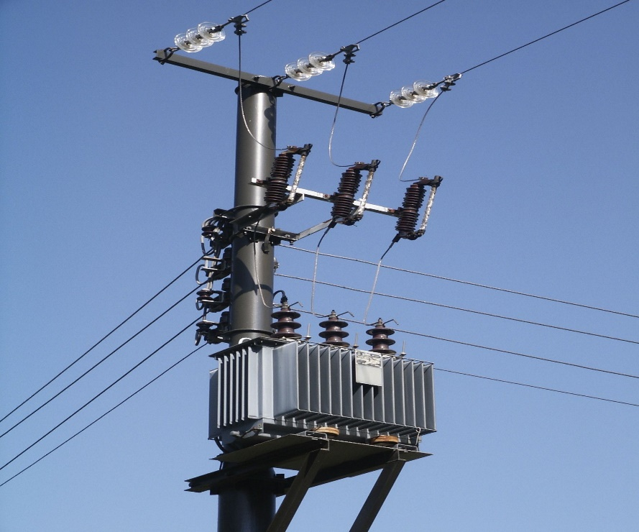
Resistance
e
e
e
Internal resistance (R) of wire
260 V
240 V
e

Slide 8
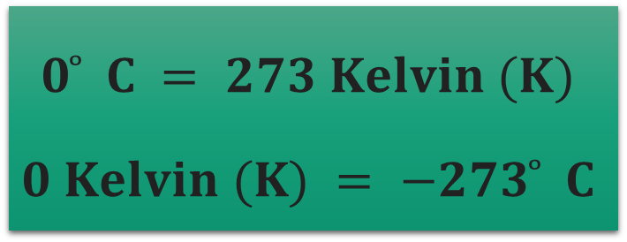
Before Superconductivity
Before the discovery of superconductivity it was thought that the electrical
resistance of a conductor becomes zero only at absolute temperature.
But it was found that in some materials electrical resistance becomes zero when
cooled to very low temperature.
These materials are nothing but the superconductors.
R
$$0 ̊ C = 273 Kelvin (K)$$
$$0 Kelvin (K) = −273 ̊ C$$
T
0 K

Slide 9
Superconductivity
Superconductivity was discovered by Dutch physicist Kammerlingh Onnes in the Year 1911.
It was first observed in Mercury (Hg) at 4.2K (The resistivity was of an order of ̴ 10⁻⁵ Ωm)
The phenomena in which certain metals, alloys or ceramics conduct electricity without
resistance, when they are cooled below a certain temperature called critical temperature (T_{c}) is
called “super conductivity”.
A superconductor is a material that loses almost all its resistance (offers almost zero
resistance) to the flow of electrical current, when it is cooled down below a certain temperature
called “critical temperature (Tc).”
e.g. Mercury (Hg), Zinc (Zn), Vanadium (V), Niobium (Nb)

Slide 10
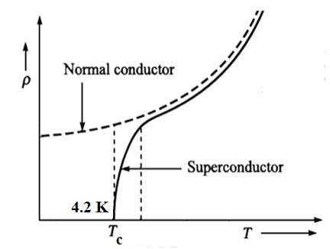
Critical temperature (T_{c})
“The temperature at which a materials electrical resistivity drops down to
absolute zero is called critical or transition temperature (T_{c}).”
We can see from the graph that electrical resistivity
of normal conductor decreases steadily or gradually
as temperature is decreased and reaches a low
value at 0 K.
Whereas, resistivity of a superconductor decreases
suddenly at T_{c}.
A superconductor remains in S.C. state ( ̴ no resistance) at T_{c} or lower than T_{c}.

Slide 11
Properties of superconductors
1. Electrical resistance/resistivity:
Electrical resistance of a superconductor is very low, of an order of 10⁻⁷ Ωm.
e⁻
e⁻
e⁻
e⁻
e⁻
e⁻
e⁻
e⁻

Slide 12
Properties of superconductors
2. Effect of Impurities:
Electrical When impurities are added to a superconducting material, it’s superconducting
property is not lost but value of T_{c} is lowered or can be increased.
Material | T_{c} (K) | Material | T_{c} (K)
Ga | 1.09 | V₃Ga | 16.5
Al | 1.196 | Nb₃Al | 18.0
Nb | 9.25 | Nb₃Sn | 18.5
V | 5.1 | V₃Si | 17.0

Slide 13
Properties of superconductors
3. Effect of Pressure and Stress:
Certain material are found to exhibit superconductivity on incising pressure over them. e.g.
Cesium (Cs) is found to exhibit superconductivity at T_{c} = 1.5 K on applying a pressure of 100
K Bar.
On increasing pressure, the atoms comes closer. In some materials the lattice vibrations are
reduced, as a result of this, the electrons can move freely. i.e. resistivity (and hence
resistance) decreases.
e⁻
e⁻
e⁻
e⁻
e⁻
e⁻
e⁻
e⁻
e⁻
e⁻
e⁻
e⁻
e⁻
e⁻
e⁻
e⁻

Slide 14

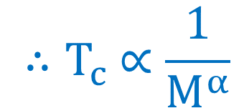
Properties of superconductors
4. Isotopic effect:
The critical temperature (T_{c}) is found to vary with it’s isotopic mass.
This variation in T_{c} with it’s isotopic mass is called ‘Isotopic effect’.
Isotopes have different no. of neutrons in the nucleus. As a result, they have same
atomic number but different atomic mass. e.g. : $C_{6}^{12}, C_{6}^{14}, C_{6}^{16}$
$${M^{α} T}_{c}=constant$$
Where, α = isotopic constant (Its approx. value is 0.5)
Material | α
Hg | ̴ 0.5
Zn | ̴ 0.45
Cd | ̴ 0.32
$${ ∴T}_{c} ∝\frac{1}{M^{α}}$$

Slide 15

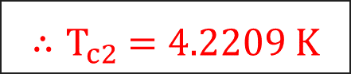
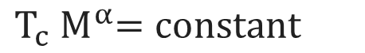

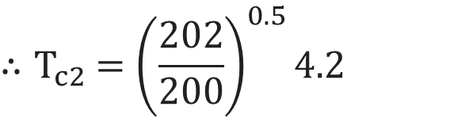
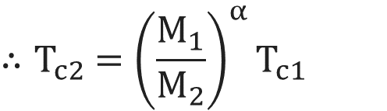
Examples
Q.1 For mercury of mass 202, value of α is 0.5 and T_{c} is 4.2 K. Find transition temperature for
Isotope of mercury of mass 200.
Solution:
M₁ = 202
T_{c1} = 4.2 K
M₂ = 200
α = 0.5
T_{c2} = ?
$${∴T}_{c2} ={\left(\frac{202}{200}\right)}^{0.5}4.2$$
$${ T}_{c}{ M}^{α}=constant$$
$${ ∴T}_{c1}M_{1}^{α}={ T}_{c2}M_{2}^{α}$$
$${∴T}_{c2} =1.004987×4.2$$
$${∴T}_{c2} ={\left(\frac{M_{1}}{M_{2}}\right)}^{α}T_{c1}$$
$${∴T}_{c2} =4.2209 K$$

Slide 16
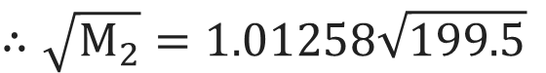

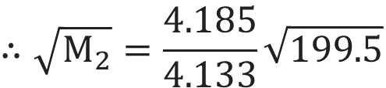

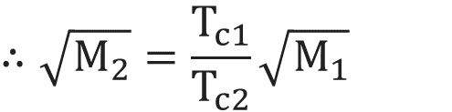
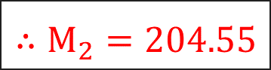
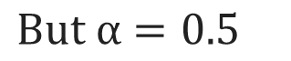
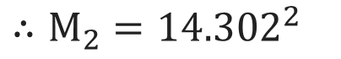
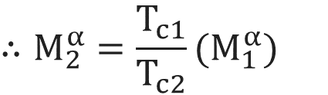
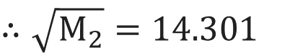
Examples
Q.2 The critical temperature of a metal with isotopic mass 199.5 is 4.185 K. Calculate the
isotopic mass if critical temperature falls to 4.133 K.
Solution:
M₁ = 199.5
T_{c1} = 4.185 K
T_{c2} = 4.133 K
M₂ = ?
$${ T}_{c}{ M}^{α}=constant$$
$$But α=0.5$$
$$∴\sqrt{M_{2}}=1.01258\sqrt{199.5}$$
$$∴\sqrt{M_{2}}=\frac{T_{c1}}{T_{c2}}\sqrt{M_{1}}$$
$$∴\sqrt{M_{2}}=14.301$$
$${ ∴T}_{c1}M_{1}^{α}={ T}_{c2}M_{2}^{α}$$
$$∴M_{2}={14.302}^{2}$$
$$∴M_{2}^{α}=\frac{T_{c1}}{T_{c2}}(M_{1}^{α})$$
$$∴\sqrt{M_{2}}=\frac{4.185}{4.133}\sqrt{199.5}$$
$$∴M_{2}=204.55$$

Slide 17
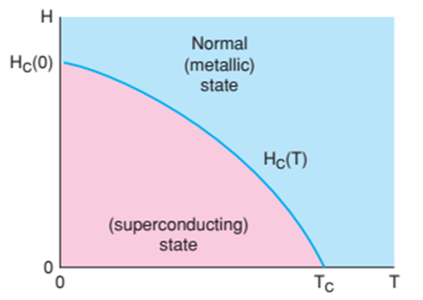
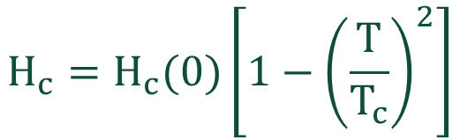
Properties of superconductors
5. Magnetic field effect:
“The minimum magnetic field required to destroy the superconducting state is
called critical magnetic field (H_{c}).”
$$H_{c}=H_{c}(0)\left[1−{\left(\frac{T}{T_{c}}\right)}^{2}\right]$$
H_{c} (0) is the maximum field at absolute zero (0 K) temperature.
N
T_{c}
S

Slide 18
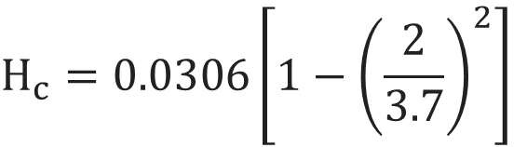
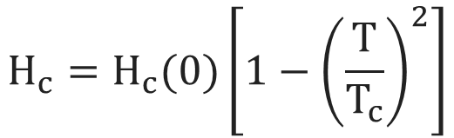
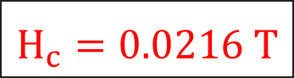
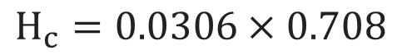
Examples
Q.1 A superconductor tin has a critical temperature of 3.7 K in zero magnetic field and a critical
field of 0.0306 T at 0 K. Find the critical field at 2 K.
Solution:
Given that
H_{c}(0) = 0.0306 T
T_{c} = 3.7 K
T = 2 K
H_{c} = ?
$$H_{c}=H_{c}(0)\left[1−{\left(\frac{T}{T_{c}}\right)}^{2}\right]$$
Now, the critical field at any temperature T K is given as:
$$H_{c}=0.0306\left[1−{\left(\frac{2}{3.7}\right)}^{2}\right]$$
$H_{c}=0.0306×0.708$
$H_{c}=0.0216 T$

Slide 19
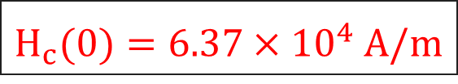
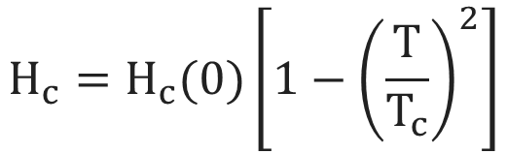
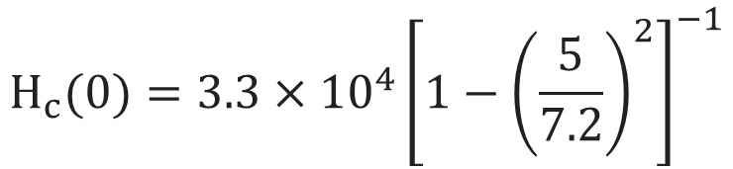
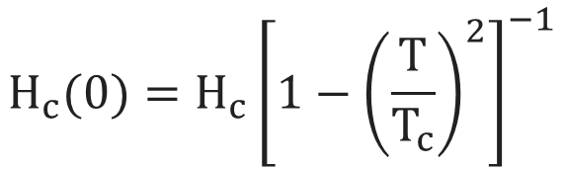
Examples
Q.2 The transition temperature for lead is 7.2 K. However, at 5 K, it loses the superconducting
property when subjected to a magnetic field of 3.3 × 10⁴ A/m. Find the value of the
magnetic field that will allow the metal to remain its superconductivity at 0 K.
Solution:
Given that
T_{c} = 7.2 K
T = 5 K
H_{c} = 3.3 × 10⁴ A/m
H_{c} (0) = ?
$$H_{c}=H_{c}(0)\left[1−{\left(\frac{T}{T_{c}}\right)}^{2}\right]$$
$$H_{c}(0)=3.3×{10}^{4}{\left[1−{\left(\frac{5}{7.2}\right)}^{2}\right]}^{−1}$$
$$H_{c}(0)=H_{c}{\left[1−{\left(\frac{T}{T_{c}}\right)}^{2}\right]}^{−1}$$
$H_{c}(0)=6.37×{10}^{4} A/m$

Slide 20
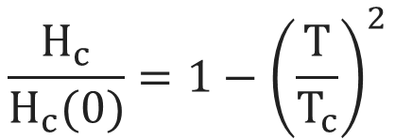
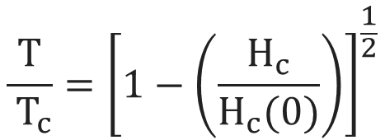
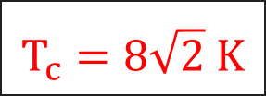
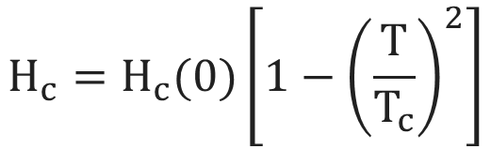
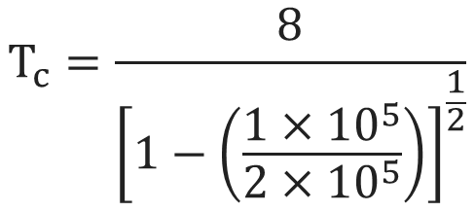
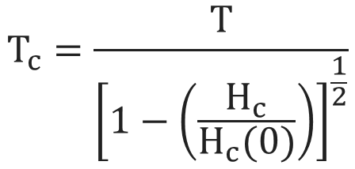
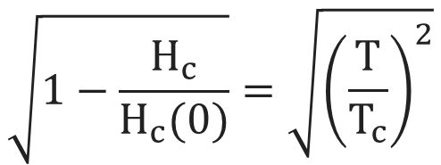
Examples
Q.3 Calculate the transition temperature of niobium for which the critical field is 1×10⁵ A/m at
8 K and 2×10⁵ A/m at 0 K.
Solution:
Given that
H_{c} = 1 × 10⁵ A/m
T = 8 K
H_{c}(0)= 1 × 10⁵ A/m
T_{c} = ?
$$H_{c}=H_{c}(0)\left[1−{\left(\frac{T}{T_{c}}\right)}^{2}\right]$$
$$\frac{ T }{ T_{c}}={\left[1−\left(\frac{H_{c}}{H_{c}(0)}\right)\right]}^{\frac{1}{2}}$$
$$T_{c}=\frac{8}{{\left[1−\left(\frac{1×{10}^{5}}{2×{10}^{5}}\right)\right]}^{\frac{1}{2}}}$$
$$\frac{H_{c}}{H_{c}(0)}=1−{\left(\frac{T}{T_{c}}\right)}^{2}$$
$$T_{c}=\frac{T}{{\left[1−\left(\frac{H_{c}}{H_{c}(0)}\right)\right]}^{\frac{1}{2}}}$$
$$T_{c}=8\sqrt{2} K$$
$$\sqrt{1−\frac{H_{c}}{H_{c}(0)}}=\sqrt{{\left(\frac{T}{T_{c}}\right)}^{2}}$$

Slide 21
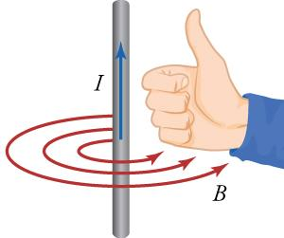
Properties of superconductors
6. Critical current density (J_{c}):
When current density through a superconductor exceeds a critical value J_{c}, the
superconducting state is found to disappear in the sample.
L = 1 m
The maximum current per unit area passing in a material.
e⁻
e⁻
A
e⁻
e⁻
e⁻
e⁻
Cu (Wire)
When This is because, when current flows through the
superconductor, it itself generates a magnetic field at sufficiently
high current density, the magnetic field will start exceeding the value
of H_{c}, hence superconducting state will start disappearing.

Slide 22
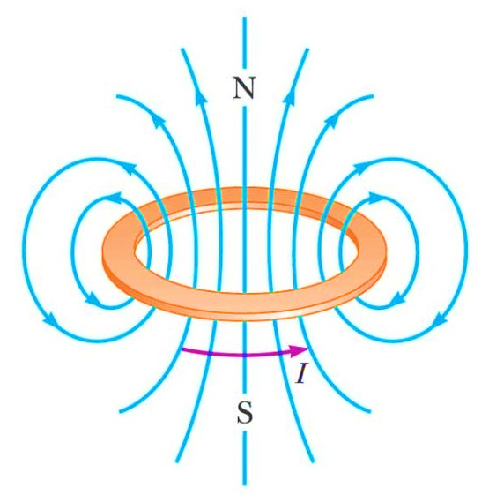
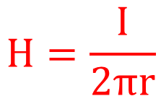
Properties of superconductors
Hence, the critical current density (J_{c}) can be defined as the maximum current that can be
permitted in a superconducting material without destroying superconducting state.
Silsbee’s law
To derive the relation between critical current field (I_{c}) and
magnetic field (H_{c}), consider a superconductor wire of radius ‘r’
carrying current ‘I’.
By using Amperes circuital law
$$H=\frac{I}{2πr}$$
Produced magnetic field will be:
If produced magnetic field (H) > (H_{c}) then superconducting state will be vanished.

Slide 23
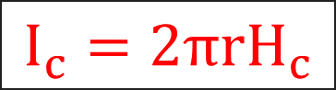
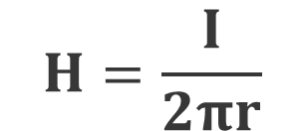
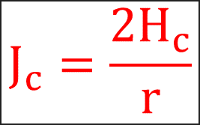
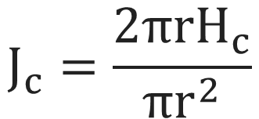
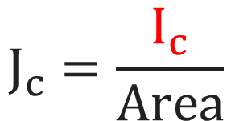
Properties of superconductors
So, the relation between critical current (I_{c}) and critical magnetic field (H_{c}) is given by:
Amperes circuital law
$$I_{c}=2πrH_{c}$$
$$H=\frac{I}{2πr}$$
Magnetic field
Similarly, the relation between critical current density (J_{c}) and critical current (I_{c}) is given by:
$$J_{c}=\frac{I_{c}}{Area}$$
/
/
$$J_{c}=\frac{2πrH_{c}}{πr^{2}}$$
$$J_{c}=\frac{2H_{c}}{r}$$
/
/

Slide 24
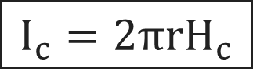
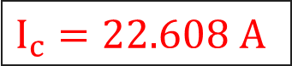
Examples
Q.1 Calculate the critical current through a long thin superconducting wire of radius 0.5 mm.
The critical field is 7.2 × 10³ A/m.
Solution:
Given that
H_{c} = 7.2 × 10³ A/m
r = 0.5 mm = 0.5 × 10⁻³ m
I_{c} = ?
According to Silsbee’s law,
$$I_{c}=2πrH_{c}$$
$$I_{c}=\left(2π\right) \left(0.5×{10}^{−3}\right)\left(7.2×{10}^{3}\right)$$
$$I_{c}=22.608 A$$

Slide 25
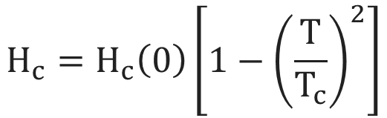
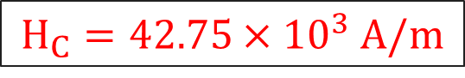
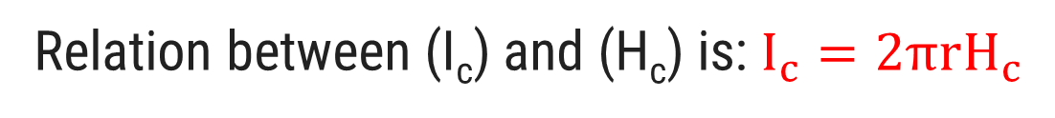
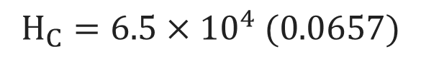


Examples
Q.2 Calculate the critical current for a superconducting wire of lead (Pb) having a diameter of
1 mm at 4.2 K. Critical temperature of lead is 7.18 K and H_{c(0)} is 6.5 × 10⁴ A/m.
Solution:
Given that
H_{c(0)} = 6.5 × 10⁴ A/m
T_{c} = 7.18 K
r = 0.5 mm = 0.5 × 10⁻³ m
T = 4.2 K
I_{c} = ?
H_{c} = ?
$$H_{c}=H_{c}\left(0\right)\left[1−{\left(\frac{T}{T_{c}}\right)}^{2}\right]$$
Relation between (I_{c}) and (H_{c}) is: $I_{c}=2πrH_{c}$
$$H_{C}=6.5×{10}^{4} (1−0.342)$$
We know,
$$H_{C}=6.5×{10}^{4} (0.0657)$$
$$H_{c}=6.5×{10}^{4}\left[1−{\left(\frac{4.2}{7.18}\right)}^{2}\right]$$
$$H_{C}=42.75×{10}^{3} A/m$$

Slide 26


Examples
Q.2 Calculate the critical current for a superconducting wire of lead (Pb) having a diameter of
1 mm at 4.2 K. Critical temperature of lead is 7.18 K and H_{c(0)} is 6.5 × 10⁴ A/m.
According to Silsbee’s law:
$$I_{c}=2πrH_{c}$$
$$I_{c}=\left(2π\right) \left(0.5×{10}^{−3}\right)\left(4.2×{10}^{3}\right)$$
$$I_{c}=134.26 A$$

Slide 27
Properties of superconductors
7. Persistent current:
When current is made to flow through a superconducting ring (A loop of wire) which is at a
temperature equal to or less than its critical temperature, it is observed that current flows
through the material without any significant loss in it value.
The steady flow of current in a superconducting material is called “persistent Current”.
e⁻
P.D.

Slide 28
Properties of superconductors
Current can be induced in a superconductor by applying magnetic field to it and then
switching off the magnetic field.
When the magnetic field is switched off, the field outside the ring disappears, but field
inside the ring is trapped.
Once current is induced, even though the field is switched off, it persists for indefinite
period (till its superconducting state is maintained).
e⁻
N
S

Slide 29


Properties of superconductors
8. Meissner effect:
When a material makes the transition from the normal to the superconducting state, it
actively excludes magnetic field from its interior and the superconductor becomes a
perfect diamagnetic. This phenomena is called “Meissner effect”.
This magnetic field lines per unit area are called magnetic flux.
$$B≠0$$
$$B=0$$
Normal State
Superconducting State
T > T_{c}
H > H_{c}
T < T_{c}
H < H_{c}

Slide 30
Properties of superconductors
When magnetic field is applied to the material, due to passing of surface current, so
the magnetic field is created within the superconducting material.
This magnetic field will exactly counter the applied magnetic field, they cancel each other
everywhere inside the material.
T
T_{c}
N
S
N
S

Slide 31












Properties of superconductors
$To prove χ_{m}=−1 \left(perfect diamagnetism\right) for superconductors:$
The magnetic induction or magnetic flux density (B) is given by
$$B=μ_{0}(H+M)$$
$$0=μ_{0}(H+M)$$
$$μ_{0}=Permeability of free space$$
$$But μ_{0} can^{′}t be zero (μ_{0}=4π×{10}^{−7})$$
$$M=Intensity of magnetisation$$
$$∴M+H=0$$
$$H=Applied magnetic field$$
$$∴M=−H$$
$$∴\frac{M}{H}=−1$$
$$\left(χ_{m}=\frac{ M }{H}\right)$$
For superconductor $B = 0$
$$∴χ_{m}=−1$$

Slide 32
Important Factors to Define a Superconducting State

Slide 33
Important Factors to Define a Superconducting State
In general, the superconducting state is defined by three important factors:
Critical temperature T_{c}
Critical current density J_{c}
Critical magnetic field H_{c}
T_{c}
H_{c}
To sustain a superconducting state, it is
necessary to have all above factors
below their critical values.
J_{c}

Slide 34
Important Factors to Define a Superconducting State
The values of H_{c} and J_{c} are maximum at T = 0 K
while highest values of T_{c} occurs when H and J are
at value 0.
This plot refers to as “critical surface”.
Within this surface, material is in superconducting
state and outside this surface, it is in normal state.
T_{c}
H_{c}
J_{c}

Slide 35
Types of Superconductors

Slide 36
Type-I Superconductors
Type-I superconductors are also known as soft superconductors.
They exhibit complete Meissner effect.
The transition from superconducting state (S.C.) to normal
state occurs at critical value H_{c}.
Value of H_{c} for type-I superconductor is very low (of an
order of 0.1 Tesla).
They allow field penetration easily e.g. Lead (Pb), Tin (Sn),
Vanadium (V).
Magnetization (M)
Normal
State
S.C.
State
H_{c}
Applied field (H)

Slide 37

Type-II Superconductors
Type-II superconductors are also known as hard superconductor.
Mixed or Vortex state
Magnetization (M)
$$B≠0$$
$$B=0$$
Normal
State
S.C.
State
Normal State
Superconducting State
H_{c1}
H_{c2}
Applied field (H)
Lower critical
field
Upper critical
field

Slide 38

Type-II Superconductors
Mixed or Vortex state
S.C. State
Normal State
Magnetization (M)
$$B=0$$
H_{c1}
H_{c2}
Applied field (H)
Meissner effect

Slide 39
Type-II Superconductors
Type-II superconductors are also known as hard superconductor.
Till the applied magnetic field is equal to H_{c1}, the material
Is perfectly diamagnetic and excludes all field lines.
If the applied magnetic field is increased beyond H_{c1}, field
lines start penetrating the material till it reaches the H_{c2}.
If applied field is increased beyond this point, the field
Inside superconductor and applied field becomes equal.
In between H_{c1} and H_{c2}, the superconductor is in mixed state.
Mixed or Vortex state
Magnetization (M)
Normal
State
S.C.
State
Applied field (H)
H_{c1}
H_{c2}
Value of H_{c2} for type-II S.C. is 100 times or even more as compared to type-I S.C.
Because of relatively large magnetic field requirement for type-II S.C. are called hard S.C.
E.g. YBCO (Y₁Ba₂Cu₃O₇), Nb - Ti (Niobium titanium)

Slide 40
Difference between Type-I and Type-II superconductors
Type-I superconductors | Type-II superconductors
They are called soft superconductors | They are known as hard superconductors
They exhibit complete Meissner effect | They do not exhibit complete Meissner effect
They show perfect diamagnetic behavior | They do not show perfect diamagnetic behavior
They have only one critical magnetic field (H_{c}) | They have two critical magnetic fields, lower critical magnetic field (H_{c1}) and upper critical magnetic field (H_{c2})
There is no mixed or intermediate state in case of these materials | Mixed or intermediate state is present in these materials
They have limited applications because of low field strength. e.g. Pb, Hg, Zn, Nb | They have wider technical applications because of high field strength. e.g. Nb-Sn, Va-Ga, YBCO

Slide 41
Type of superconductors
Superconductors are divided into low T_{c} and high T_{c} superconductors based on
their transition temperature.
Low temperature superconductors:
Superconductors that require liquid helium as a coolant are called low temperature
superconductors.
Temperature of liquid helium is 4.2 K above absolute zero (0 K).

Slide 42
Type of superconductors
(b) High temperature superconductors:
Superconductors having their critical temperature (T_{c}) value above the temperature
of liquid nitrogen are called high temperature superconductors.
After the discovery of superconductivity in Hg by K. onnes in 1911, the critical
temperature (T_{c}) had been gradually increased from 4.2 K to 23 K in a compound
Nb₃Ge, in the year 1973.
This remained a record till the year 1986, when J. George and K. A. Muller, using
different materials, synthesized by Michel, broke the record of 23 K with a
compound of barium, lanthanum, copper and oxygen at a temperature of 30 K.
Similar materials with higher transition temperature soon followed when
Y1Ba2Cu3O7 (YBCO) or the so called 1-2-3 compound was discovered in 1987.

Slide 43
Type of superconductors
(b) High temperature superconductors:
It was the first compound having a critical temperature higher than liquid nitrogen.
After YBCO, more than 50 cuprates are now known having high critical temperatures.
Currently, the highest known critical temperature is 138 K in thallium doped mercury
cuprate.
comprised of elements like Hg, Tl, Ba, Ca, Cu and oxygen.
Material | Temperature (K)
Pb₂YSr₂Cu₃O₈ | 77
Y-Ba-Cu-O (Y₁Ba₂Cu₃O₇) | 93-95
Hg-Ba-Ca-Cu-O | 130-135

Slide 44
Mechanism of superconductivity
BCS theory

Slide 45
BCS theory
BCS theory, in 1957 given by John Bardeen, Leon Cooper and Robert Schrieffer.
It explains the phenomena in which current flows due to electron pairs flows without resistance
in certain materials at low temperature.
In brief, the theory says that when a single negatively charged electron slightly distorts the lattice
of atoms in a superconducting material, drawing towards a small excess of positive charge. This
excess in turn attracts the second electron.
It is this weak, indirect interaction that binds electrons together, as cooper pair.
Layered atomic arrangement is known as lattice.
Lattice vibration (due to thermal energy) = Phonon
e⁻

Slide 46
Explanation of BCS theory
BCS theory shows that the basic interaction responsible for superconductivity
appears to be that of a pair of electrons by means of an interchange of virtual
phonons.
e⁻
e⁻
e⁻
Phonon field
Second
electron
First electron

Slide 47
Explanation of BCS theory
Suppose an electron approaches a positive iron core. It suffers attractive Coulomb Interaction.
Due to this interaction, iron core is set in motion and consequently distorts the lattice, smaller the
mass of positive iron core, higher will be the distortion.
Suppose another electron comes towards that side and sees the distorted lattice, then the
Interaction between the electron and distorted lattice occurs, which lowers the energy of second
electron.
We can see this as if the two electrons interacts via phonon field, lowers the energy of electrons.
So, lowering of energy of electron implies weak force between electrons is attractive.
This type of interaction is called electron-lattice interaction.

Slide 48
Explanation of BCS theory
This attraction is the strongest if two electrons have equal and opposite momentum and spin.
As this is oscillatory distortion is quantized in terms of phonons, the above interaction can be
Interpreted as Electron-Electron interaction through phonons as mediator.

Slide 49
Explanation of BCS theory
+
+
K – q
K’ + q
e⁻
e⁻
q
+
+
e
e
e⁻
e⁻
k
K’
Suppose an electron of wave vector k is emitted a phonon q which is absorbed by an electron k’.
Here, 1st electron emits phonon so, it will be k – q and 2nd electron absorbs this phonon and
becomes k’ + q.
These electron forms cooper pairs.

Slide 50
Cooper Pairs
The fundamental of BCS theory is that superconductivity occurs when an attractive interaction
between two electrons, by mean of phonon exchange takes place. This dominates the usual
repulsive Coulomb interaction.
“ Two such electrons which interacts alternatively in phonon field are called Cooper Pairs.”
The energy of cooper pairs of electrons in bound state is less than the energy of electron in free
state.
This difference in energy is due to binding energy, which is supplied if the pair is broken.
At lower temperature (lower than T_{c}), the electron-electron lattice interaction is stronger than
electron-electron Coulomb repulsive interaction, which leads to pairing up of valence electrons.
This pairing is complete at T = 0 K and completely broken at critical temperature (T_{c}).

Slide 51
Energy gap
“The energy difference between the free state of an electron (i.e. energy of individual electron)
and the paired state (i.e. energy of paired electron) appears as the energy gap at the fermi
surface”.
Fermi surface is the surface which separates occupied from unoccupied electron states at zero temperature.
The normal electron states are above the energy gap and superconducting
electron states are below the energy gap.
The energy gap in superconductors is a function of temperature.
As the pairing is complete at T = 0 K, the difference in energy of free
electron states is maximum.
e⁻
E_{g}
e⁻ - e⁻
BCS theory predicts that the energy gap in superconductors at T = 0 K is E_{g} = - 3.53 K_{B}T_{C}.
This equation can be verified by the absorption of electromagnetic radiation.
Photons with energies equal to or grater than energy gaps can be absorbed.

Slide 52
Coherence length
The paired electrons are not scattered because of their peculiar property of smoothly riding
over the lattice imperfections without exchanging energy with them.
The concept of coherence can be explained by the fact that superconductivity is due to mutual
Interaction and correlation of electrons that extend upto a considerable distance.
The maximum distance upto which the state of paired electrons are correlated to produce
superconductivity is called Coherence length (ε₀).
The paired electrons can be thousands of atomic spacing approx.
(0.001 nm) apart.
The properties of a superconductor depends on the correlation of
electrons within a volume (ε₀)³. This is mainly because, a large no. of
electrons in such a volume act together to produce superconductivity
with an extremely sharp transition.
e⁻
e⁻

Slide 53
Penetration depth:
London equations

Slide 54


Penetration depth
$$B≠0$$
$$B=0$$
$$B=0$$
λ_{L}
λ_{L}
Normal State
Superconducting State
T > T_{c}
H > H_{c}
T < T_{c}
H < H_{c}
Strong magnetic
field
Weak magnetic
field
λ_{L} = Penetration depth

Slide 55


Penetration depth
It is a concept proposed by London brothers in the year 1935, that described the Meissner effect.
In a superconductor the London penetration depth (λ_{L}) characterizes the distance to which a
Magnetic field penetrates into a superconductor.
The exponential decay of magnetic field at the interior surface of superconductor.
X | = distance inside the superconductor from surface
B₀ | = Magnetic field at the surface
λ_{L} | = Penetration depth
$$B\left(x\right)=B_{0} e^{\left(\frac{ −x }{λ}\right)}$$
$$λ_{L}=\sqrt{\frac{m}{μ_{0 }n_{s} q^{2}}}$$
λ _{L} can be calculated by:

Slide 56

Penetration depth / London penetration depth
λ_{L}
B
$$B=0$$
λ_{L}
λ_{L}
Applied
magnetic field
x
$$B\left(x\right)=B_{0} e^{\left(\frac{ −x }{λ}\right)}$$

Slide 57





London equations
Basic: Maxwell’s equations (just for information)
ρ_{q} = volume charge density
$$\vec{∇}∙\vec{E}=\frac{ρ_{q}}{ε_{0}}$$
Charge produces → electric field
$$\vec{∇}=\hat{i}\frac{∂}{∂x}+\hat{j}\frac{∂}{∂y}+\hat{k}\frac{∂}{∂z}$$
$$\vec{∇}∙\vec{B}=0$$
Magnetic lines of forces are continuous in nature.
They always follow close loop.
$$\vec{∇}×\vec{E}=\frac{−∂\vec{B}}{∂t}$$
Varying magnetic field can produce electric field.
$$\vec{∇}×\vec{B}=μ_{0}\vec{J}+μ_{0}ε_{0}\frac{∂\vec{E}}{∂t}$$
Current can produce a magnetic field and varying
electric field can also produce magnetic field.

Slide 58








London equations
Contradiction of Maxwell’s equation (just for information):
$$As we know, σ=\frac{ 1 }{ρ}$$
For superconductor: T < Tc and R = 0 or ρ = 0
$$\vec{∇}×\vec{E}=\frac{−∂\vec{B}}{∂t}$$
$$Current density: \vec{j}=σ \vec{E}$$
From Maxwell’s equation:
$$∴\vec{J}=\frac{ 1 }{ρ} \vec{E}$$
$$\frac{−∂\vec{B}}{∂t}=0$$
$$\vec{B}=constant$$
$$∴\vec{J} ρ=\vec{E}$$
But from Meissner effect: T < T_{c}, H < H_{c}, B = 0
This causes the contradiction.
$$∴\vec{E}=0$$

Slide 59





London equations
London brother’s assume there are two types of electrons
Normal electrons: T > T_{c}
super electrons: T < T_{c}
When electric field is applied there will be force exerted on electrons: F = q E
$$∴m\frac{∂v}{∂t}=q E………(1)$$
$$∴ma=q E$$
Due to force there will be motion of charge, so super-current density (J): J = n q v
Where, n = concentration of super-electrons, v = drift velocity, q = electric charge
$$\frac{∂J}{∂t}=n q \frac{∂v}{∂t}………(2)$$
By taking derivation w.r.t. time:
$$From equation \left(1\right)$$
$$∴\frac{∂J}{∂t}=n q \frac{q E}{m}$$

Slide 60











London equations
$$∴\frac{∂J}{∂t}=\frac{n q^{2}E}{m}………(3)$$
$$From equation \left(1\right), ∴\frac{∂J}{∂t}=n q \frac{q E}{m}$$
Equation (3) known as first London equation.
Now, when electric field (E) becomes zero means current density (J) is constant
By taking curl of both sides of equation (3), we get
$$\vec{∇}∙\vec{E}=\frac{ρ_{q}}{ε_{0}}$$
$$∴∇×\frac{∂J}{∂t}=\frac{n q^{2}}{m}(∇×E)$$
By taking integration on both sides
$$∴\int{\frac{∂}{∂t} (∇×J)}=\frac{n q^{2}}{m}\int{\frac{−∂B}{∂t}}$$
$$\vec{∇}∙\vec{B}=0$$
$$\vec{∇}×\vec{E}=\frac{−∂\vec{B}}{∂t}$$
$$∴\frac{∂}{∂t} (∇×J)=\frac{n q^{2}}{m}(∇×E)$$
$$∴\left(∇×J\right)=−\frac{n q^{2}}{m}B………(4)$$
$$\vec{∇}×\vec{B}=μ_{0}\vec{J}+μ_{0}ε_{0}\frac{∂\vec{E}}{∂t}$$
$$∴\frac{∂}{∂t} (∇×J)=\frac{n q^{2}}{m}\frac{−∂B}{∂t}$$
Equation (4) known as second London equation.

Slide 61












London equations
The super current density is related to magnetic field ‘B’ by another Maxwell’s equation as,
$$\vec{∇}×\vec{B}=μ_{0}\vec{J}+μ_{0}ε_{0}\frac{∂\vec{E}}{∂t}$$
$$∴\frac{m}{μ_{0}n q^{2}}\left(∇×(\vec{∇}×\vec{B})\right)=−B$$
$$\vec{∇}∙\vec{E}=\frac{ρ_{q}}{ε_{0}}$$
But for electrostatic current the curl of E becomes zero.
$$\vec{∇}∙\vec{B}=0$$
$$∴\frac{m}{μ_{0}n{ q}^{2}}\left(∇×(\vec{∇}×\vec{B})\right)+B=0$$
$$\vec{∇}×\vec{E}=\frac{−∂\vec{B}}{∂t}$$
$$\vec{∇}×\vec{B}=μ_{0}\vec{J}$$
$$\frac{1}{μ_{0}}(\vec{∇}×\vec{B})=\vec{J}………(5)$$
$$\vec{∇}×\vec{B}=μ_{0}\vec{J}+μ_{0}ε_{0}\frac{∂\vec{E}}{∂t}$$
$$∴{λ_{L}}^{2}=\frac{m}{μ_{0 }n_{s} q^{2}}$$
Substituting equation (5) in equation (4), we get
$$∴\left(∇×J\right)=−\frac{n q^{2}}{m}B………(4)$$
$$∴\left(∇×\frac{1}{μ_{0}}(\vec{∇}×\vec{B})\right)=−\frac{n q^{2}}{m}B$$
Above equation defines: London
penetration depth (λ_{L}).

Slide 62




London equations
B
B₀ (max. value)
$$B\left(x\right)=B_{0} e^{\left(\frac{ −x }{λ}\right)}$$
$$B\left(x\right)=B_{0} e^{\left(−1\right)}$$
$$B\left(x\right)=\frac{B_{0}}{e}$$
$$\frac{B_{0}}{e}$$
λ_{L}
Applied
magnetic field
x
Depth in S.C.
$$The field decays to\frac{B_{0}}{e},at a distance x=λ_{L}inside the S.C. material.$$

Slide 63
Applications of Superconductors

Slide 64


Applications of superconductors
(1) Magnetic levitation:
“It is the process by which an object is suspended above another object with no other support,
but magnetic field.
This phenomena is used in Maglev train. In Maglev trains, the levitation
is brought due to presence of enormous repulsion between two highly
powerful magnetic field when a small magnet is brought close to a S.C.
magnet gets repelled.
This repulsion takes place due to the induced current in the S.C.
which is being generated by the magnetic field of the magnet.
Because of zero resistance property of the superconductor this
current persists, and thus the field due to this induced current repels
the field due to the magnet.

Slide 65

Applications of superconductors
Electromagnetic suspension:
In attractive EMS, the electromagnets installed on the train bogies attract the iron rails. The
vehicle magnets wrap around the iron guide-ways and the attractive upward force lifts the
train.

Slide 66
Applications of superconductors
Electrodynamic suspension:
This system uses repulsive force (magnet of same polarity) to levitate the train.
Magnet of same polarity creates a repulsive force between levitation magnet and guideway.
Because of S.C. is used, conduction is possible even when there is no power.
Maglev trains travel at speed of about 500 km/h. A similar magnetic
propulsion system is being used to launch the satellite into orbits directly
from the earth without the use of rockets.

Slide 67

Applications of superconductors
(2) Josephson effect:
Josephson effect was defined by Brian Josephson, in the year 1962.
This is called Josephson junction or SIS junction.
There are two type of Josephson effects: (1) D.C. & (2) A.C.

Slide 68

Applications of superconductors
D.C. Josephson effect:
When S.C. are separated by a thin insulating layer, the tunneling of electron pairs takes place
from one superconductor to another.
The cooper pairs of electrons tunnel through the insulating layer, where their thickness is very
small, of an order of 1nm.
The supercurrent (J) which is developed across the insulating junction depending on phase
difference.
A dc current is noted when there is no potential difference is applied across the junction. The
expression for the current for this effect is:
$I_{s}=I_{max} \sin{θ}$
Where theta is the phase difference between the two electrons of cooper pairs.
e⁻
e⁻
Insulator
Superconductor

Slide 69


Applications of superconductors
A.C. Josephson effect:
I
e⁻
t (sec.)
e⁻
e⁻
I
e⁻
t (sec.)
Applied voltage changes this phase difference.
$$\frac{ ∂θ }{∂t}=\frac{2eV}{ℏ}$$
Voltage causes
Due to this change we call it A.C. Josephson effect
$I_{s}=I_{max} \sin\left[\frac{2πeV}{ℏ}t+θ\right]$
The value of current is given as:

Slide 70

Applications of superconductors
A.C. Josephson effect:
When an external magnetic or electric field of potential ‘v’ is applied across the junction, the
zero-voltage current developed across the junction depending on applied field, which is the
“AC Josephson effect”.
When a potential ‘v’ is applied across the junction, cooper pairs on both the sides of the junction
differs by an energy equals to 2eV, where 2e is the charge on a cooper pair of electrons.
Since in superconductors, current is carried by cooper pairs of electrons, if a copper pair passes
across the gap, then it emits a photon of energy (hv) equal to 2eV.
$$v=\frac{2eV}{ℏ}.$$
Then, the frequency of emitted radiation is:
This is the oscillating frequency of sinusoidal current across the gap.
Suppose the P.D. across the gap is 1mV, then the frequency will be of the
order of 483.6 GHz.

Slide 71







Applications of superconductors
(3) SQUID (Superconducting Quantum Interface Devices)
It works on the principal of Josephson effect.
When current is passed through one side of superconductor, it flows equally through the
Josephson junction.
I_{c}
$$\frac{I}{2}$$
$$J$$
$$Φ$$
$$I$$
$$I$$
$$\frac{I}{2}$$
$$J$$
I_{c}
It is very sensitive to magnetic flux. Any small change in flux will lead to a change in current
and hence voltage is developed across junctions.

Slide 72

Applications of superconductors
Construction:
As shown in the diagram, it is seen that SQUID is formed when two superconductors and
insulators are arranged in such a way that they form two parallel Josephson junction.
It is connected to measuring device which can measure nominal changes in voltage and
magnetic field across junction.

Slide 73
Applications of superconductors
Working:
Current through the SQUID is highly sensitive to magnetic flux through the closed
circuit.
Evan an extremely small magnetic flux can be detected with the device.
The current through the circuit will have a periodicity which is very sensitive to the
magnetic flux passing normally through the closed circuit.
As a result, extremely small magnetic flux can be detected with this device.
This device can also be used to detect voltages as small as 10 - 15 V. Magnetic
field changes as small as 10 - 21 T can be detected.

Slide 74
Applications of superconductors
Application:
Used to measure earth’s magnetic field.
It can detect weak magnetic field produced by biological currents like human brain.
Based on these behavior, today we have (1) Magneto-Cardio Graphy (MCG)
(2) Magneto- Plethismo Graphy
Detection of iron deposition in human liver.

Slide 75
Other applications of superconductors
(1) Superconducting Magnets:
Generally, when current flows through coil, it generates magnetic field. If the coil is replaced by
a superconducting material, it generates a very large magnetic field.
In this case, there is no effect of joule heating or resistive loss.
Superconducting magnets are used in medical diagnosis, spectroscopy, magnetic levitation, etc.
Superconducting electrical generators are small in size compared to conventional electric
generators and produces more power as compared to ordinary generators.
Superconducting materials are used in no - loss transmission lines and as relays on switching
circuit.

Slide 76


Other applications of superconductors
(2) Cryotron:
Tantalum
Niobium
Two different superconducting materials are taken A= Tantalum Core and B= Niobium as
winding wire.
Taken them as such that: H_{cA} < H_{cB}.
If the current passes through winding B, it induces magnetic field.
If this induced magnetic field is grater than H_{cA}, its corresponding state will be destroyed,
thereby increasing resistivity and hence decreasing the current.

Slide 77
Other applications of superconductors
(2) Cryotron:
Tantalum
Niobium
Thus we can say that current through the winding controls superconducting state of core.
Uses:
Used in circuit breaker, relays etc…

Slide 78
Thank You

